Slide 1



Module: Data Analytics and Management
Module Project
Data-Driven HR Analytics for Attrition and Performance
Name:
Start Date: | End Date:
Submission Date: | Presentation Date:

Slide 2


Content
S. No.
Description
01
Project background
02
Objectives and Deliverables
03
List of Tools Used
04
Activity 1 - Data Transformation
05
Activity 2 - Data Modelling
06
Activity 3 - Dashboard – Overview Page
07
Activity 4 - Dashboard – Demographics Page
08
Activity 5 - Dashboard – Performance & Attrition Pages
09
Project results
10
Challenges
11
Milestones
12
Conclusion

Slide 3
1. Project Background
In today’s competitive business environment, organizations are placing increased emphasis on data-driven decision-making to manage and retain talent. Human Resource departments often collect large amounts of employee data, but lack the tools to fully analyze trends in attrition, satisfaction, and performance. Without clear insights, it becomes difficult to identify issues like low engagement, high turnover, or gaps in work-life balance.
This project addresses the growing need for advanced HR analytics by leveraging Power BI to transform raw HR data into meaningful insights. By analyzing historical datasets from 2018 to 2019, the project supports better workforce planning, helps uncover patterns in employee behavior, and enables HR teams to make more informed, strategic decisions.

Slide 4
2. Objectives and Deliverables
Project Objectives
To analyze employee attrition and performance data using Power BI.
To build interactive dashboards that help in visualizing key HR metrics.
To apply data transformation and modeling techniques for effective data analysis.
To identify patterns and insights related to employee satisfaction, involvement, and work-life balance.
To support HR decision-making by providing data-driven insights on workforce trends.
Project Deliverables
Data Import & Transformation
2. Data Modeling & Relationships
3. KPI Calculations
4. Interactive Dashboards & Visualizations
5. User-Friendly Interface
6. Final Report

Slide 5
3. List of Tools Used
Power Bi
Microsoft Excel

Slide 6
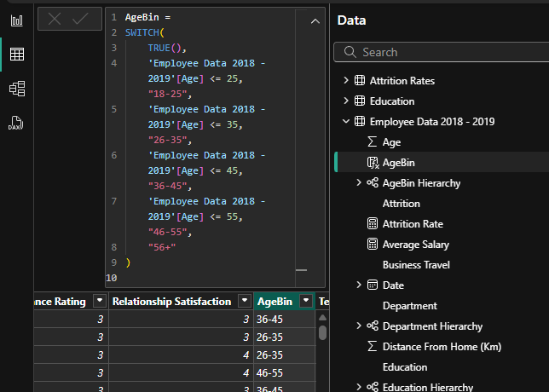
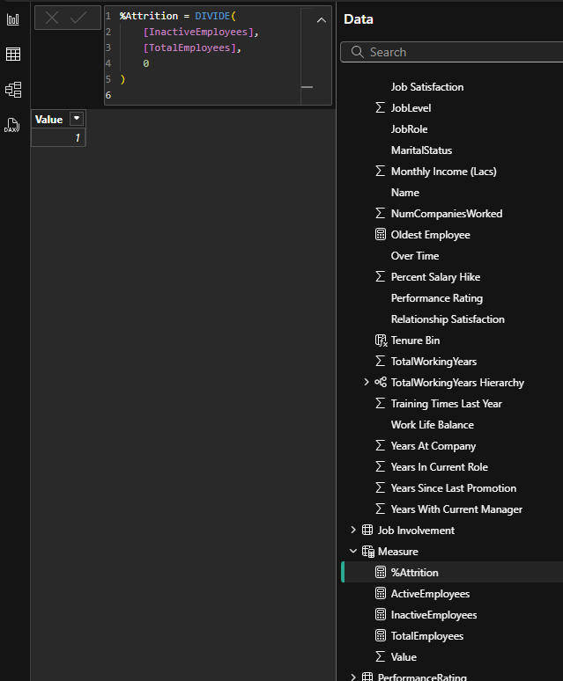
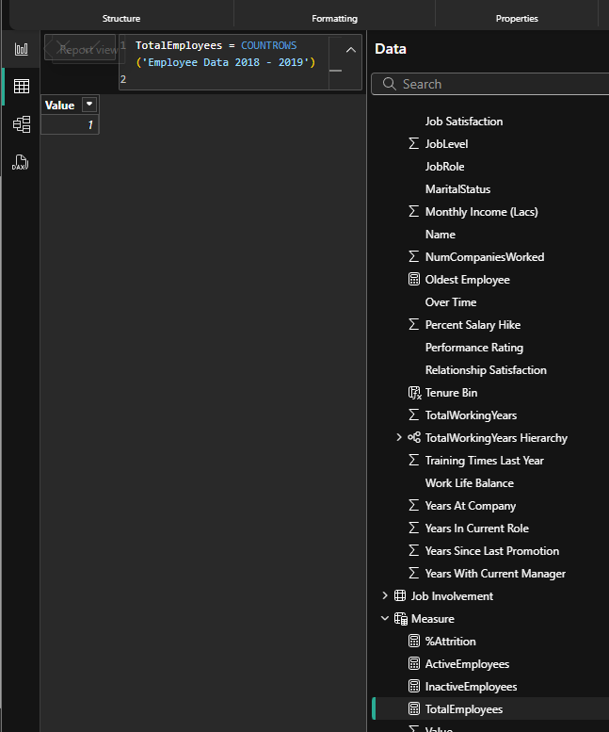
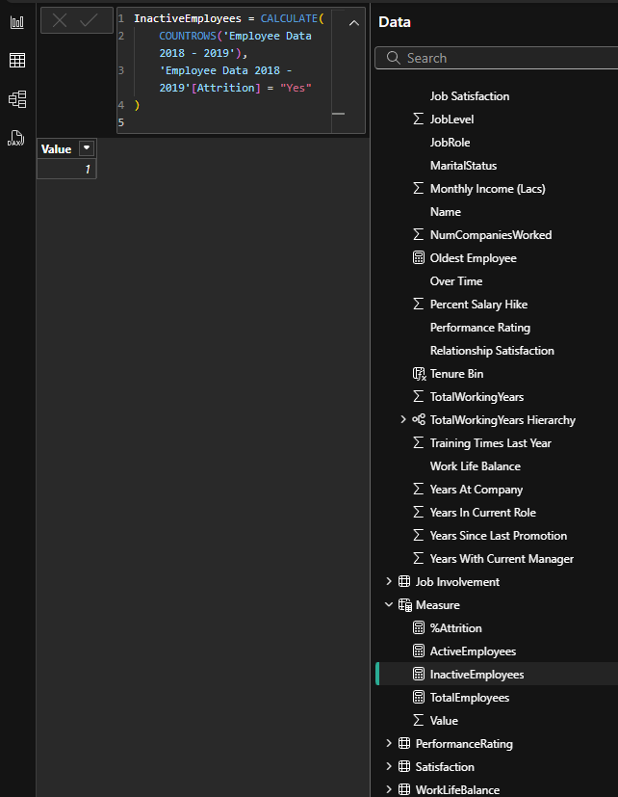
4. Data Transformation
Key transformations performed
Missing values or formatting issues fixed
Calculated columns (ex- AgeBin)
Measures created (%Attrition, TotalEmployees, etc.)

Slide 7
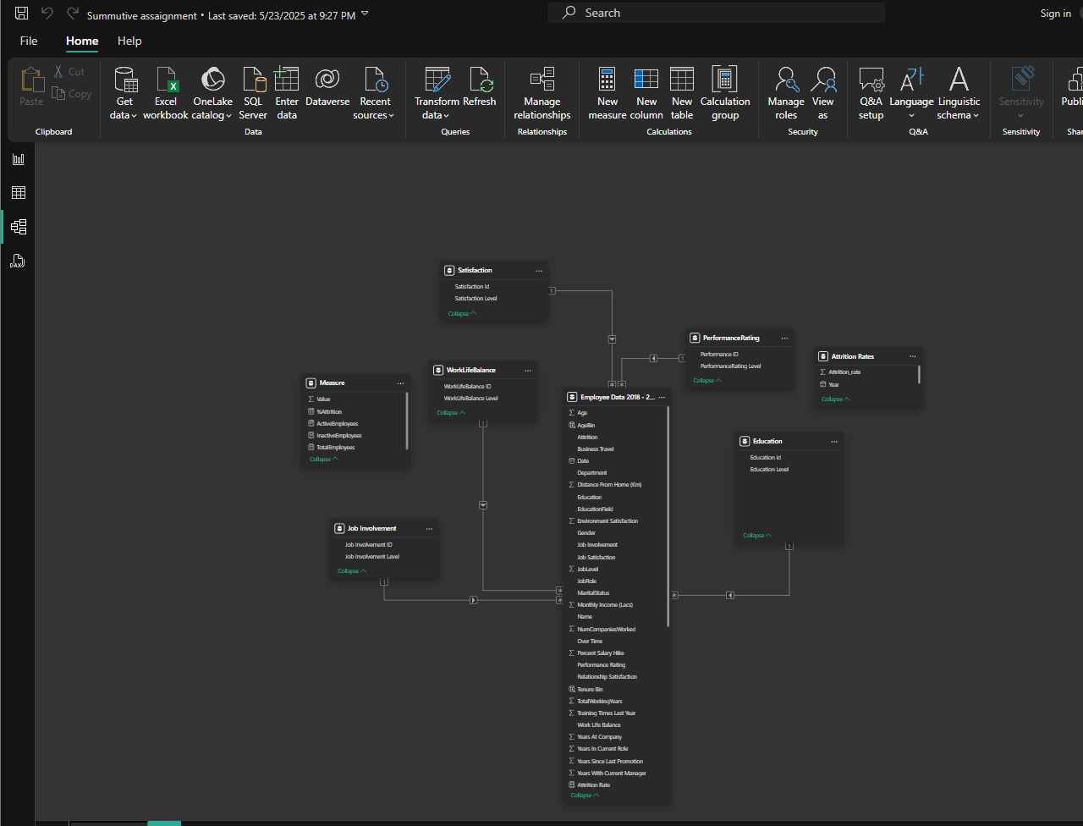
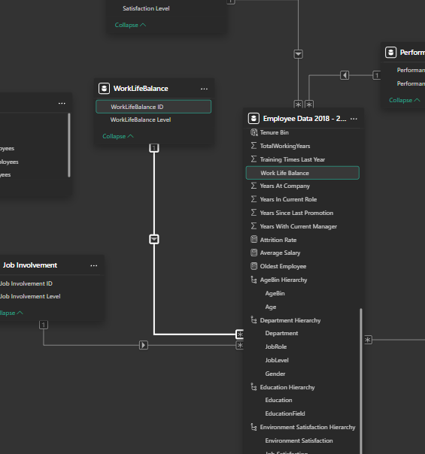
5. Data Modelling
Relationships between tables
Hierarchies created (ex- Department > JobRole)
Any model optimization details

Slide 8
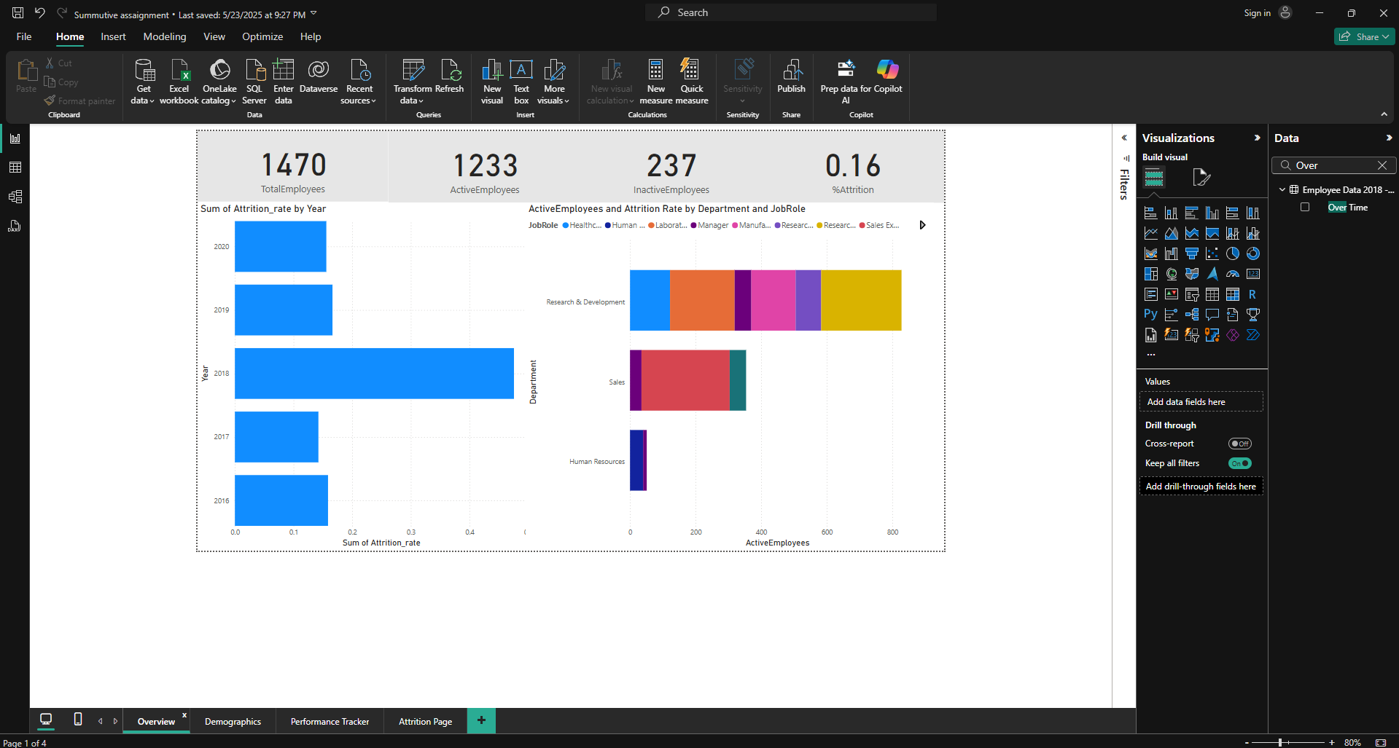
6. Dashboard – Overview Page
KPI Cards- Total Employees, % Attrition
Bar/Stacked Bar Charts (ex- Attrition by Date, by Department)
Screenshots of visualizations

Slide 9
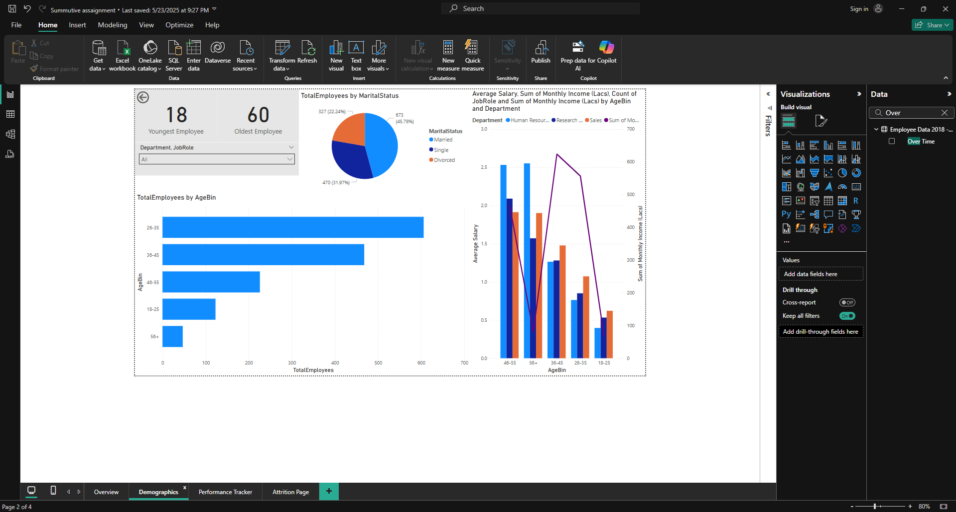
7. Dashboard – Demographics Page
KPI Cards- Youngest and Oldest Employees
Visuals- AgeBin Chart, Marital Status Pie, Avg Salary by Age/Department/JobRole
Interpretation of insights

Slide 10
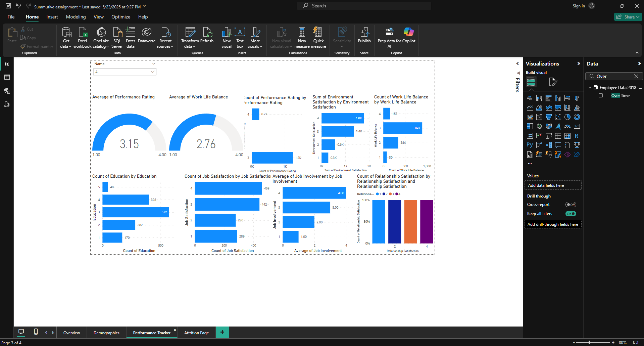
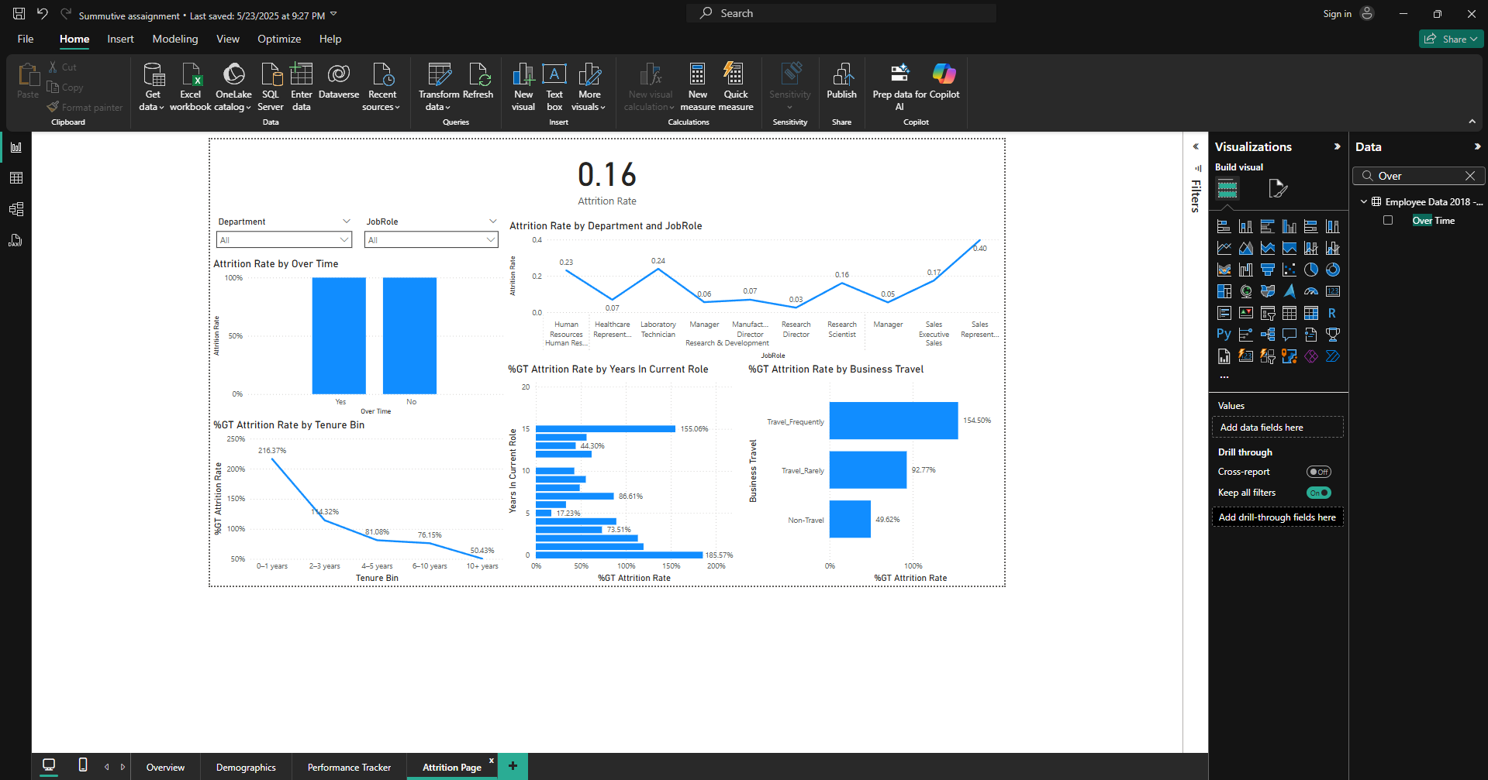
8. Dashboard – Performance & Attrition Pages
Filters/Slicers for EmployeeID
Charts for performance indicators
Gauges for Key Metrics
Attrition-related visualizations
Insights derived

Slide 11
9. Project Results
Successfully created a report displaying the emploess details in an interactive and concise report using Power bi

Slide 12
12. Conclusion
This project demonstrated the power of data analytics in addressing key HR challenges using Power BI.
By analyzing historical data from 2018–2019, we identified trends in employee attrition, performance, satisfaction, and work-life balance.
Our dashboards provide HR departments with clear, interactive visualizations that support data-driven decision-making.
Key metrics (KPIs) help monitor workforce health and reveal actionable insights for improving employee engagement and retention.
This project enhanced our skills in data transformation, modeling, DAX calculations, and dashboard design—essential tools for modern HR analytics.

Slide 13

THANK YOU

